Slide 1
Predicting CPI: A time Series Analysis
Nam Tran, Juliette Patterson, Ryan Polonski, and Yaismin Dominguez Ramirez

Slide 2
Table of CONTENTS
Introduction ……….3
Data and Preprocessing ……….4
Statistical Test ……….12
Method ……….15
Analyses and Results ……….21
Conclusion ……….25
Appendix ……….26
Notes:
2

Slide 3
Introduction
Purpose: to create a time series analysis to predict Consumer Price Index (CPI)
CPI was introduced in 1913 to aid in understanding how price changes affect purchasing power
Most common measure used for inflation
Models used: ARIMA, Random Forest, and Long Short-Term Memory
16 Predictors compiled; data collected from 1970-present.
Notes:
Nam
CPI is used to measure inflation
Answering question provides insight and info on inflation including trends, cause and effects
CPI helps make informed decisions related to economy
Financial Planning, Contracts, and Economic Policy
Evaluate changes in COL and offers useful picture of inflation trends
3

Slide 4
Data and preprocessing
Data Description
Label Decomposition
Lag Analysis
Label Transformation
Statistical Description
Correlation Analysis
Notes:
4

Slide 5
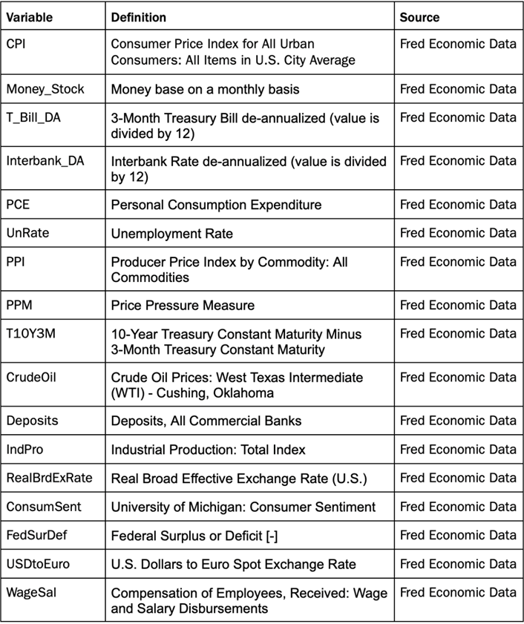
Data description
Data was sourced from the Federal Reserve Economic Data (FRED)
Original data was from 1970 to present, cut to 2010-2020
Predictors consist of economic metrics we thought to be influential to CPI and inflation
Notes:
Juliette/Nam
5

Slide 6
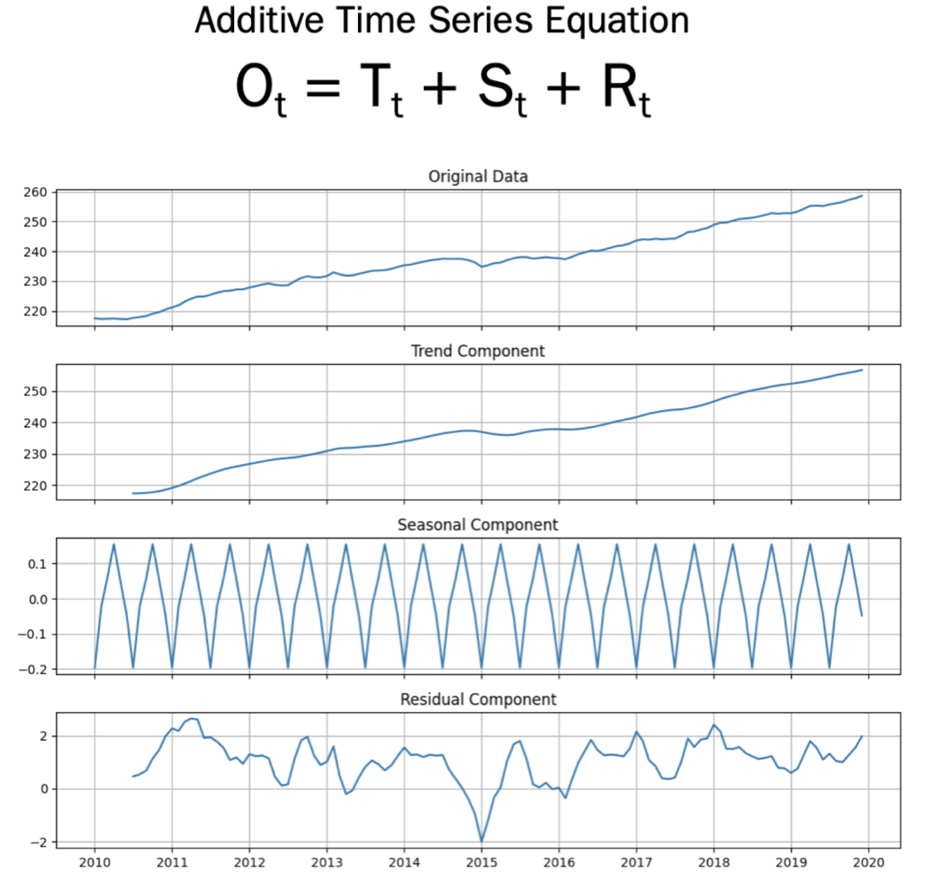
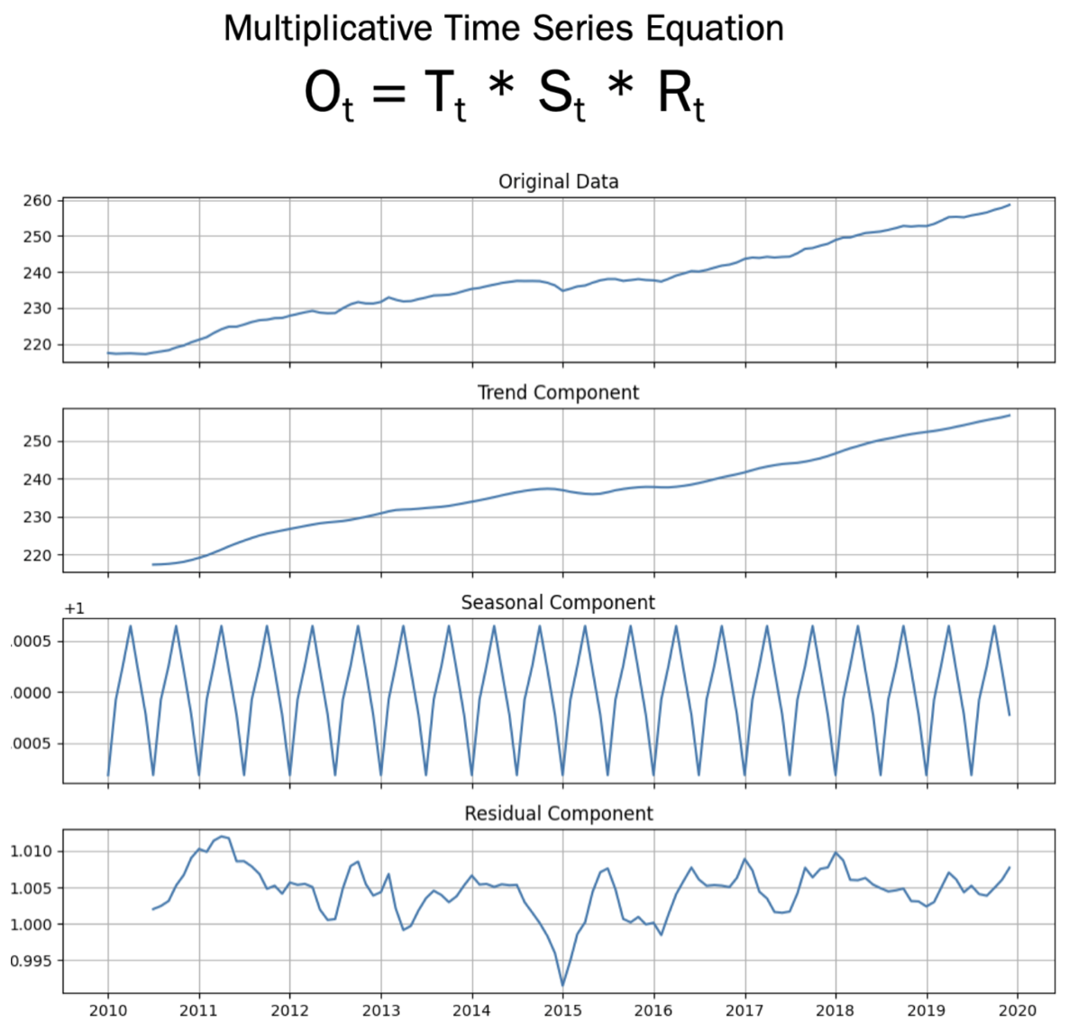
Label Decomposition
Notes:
Juliette
Ot = output; Tt = trend; St = Seasonal; Rt = Residuals; t = variable for a given time
Seasonal component is insignificant, carries the least amount of weight
Trend component is most significant
Show the values of y-axis and how they have the most effect in the equation (there scale/values are largest)

Slide 7
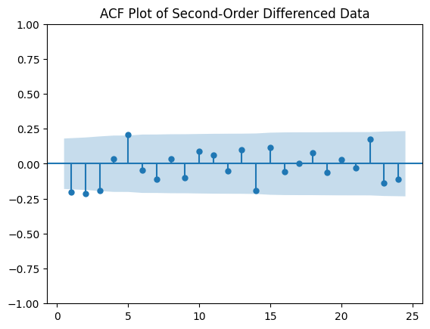
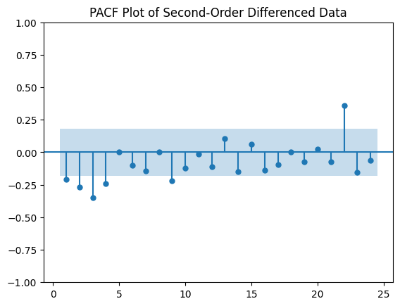
Lag analysis
ACF measures total correlation between a time series and its lagged values
PACF measures the direct correlation between a time series and its lagged values AFTER removing the effect of the correlations with intervening observations
Notes:
Juliette
Shaded area represents significance level, values outside of the shaded area are significantly correlated with the label
ACF: primarily used for MA component
first three lagged periods are significant
PACF: primarily used for AR component
first four lagged periods are significant, nine, 22 – not significant because of the small size of the data.

Slide 8
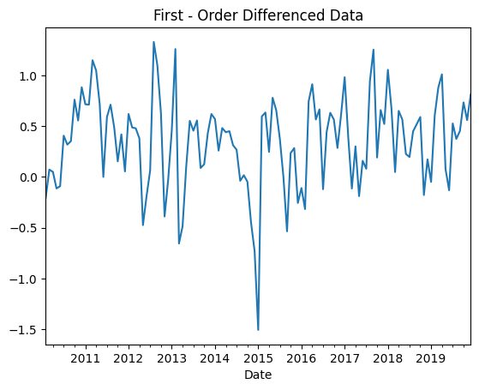
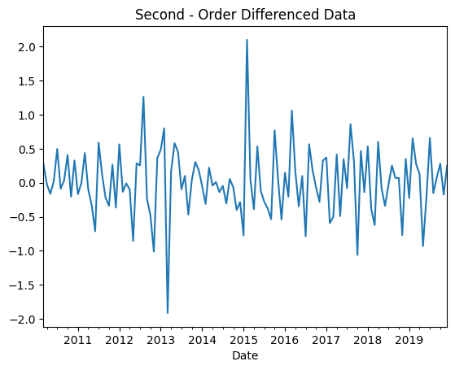
Label Transformation
Notes:
Juliette
First-Order Diff:
Goal is to eliminate trends and patterns
Subtracting each data point from the one prior
First-order loses the first value
Second-order loses the first two values (must complete first order first)
These are the outputs of the differenced data

Slide 9
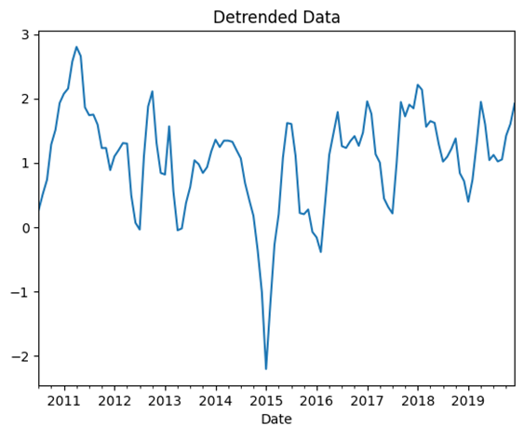
Label Transformation
Detrended data and First-Order difference reported inconsistent rolling means and standard deviations
Decided to move forward with the Second-Order Difference data to represent the CPI label
Notes:
Juliette
Detrended data removes the trend component from the original data (subtract trend values from actual values)
Used a period of six to smooth the data with a center moving average, therefore we lose six observations
Further investigation:
Rolling mean and sd of the detrended data and first-order were very unstable and not constant. Second order provided the best results in terms of mean and sd... move forward with that as our CPI label.

Slide 10
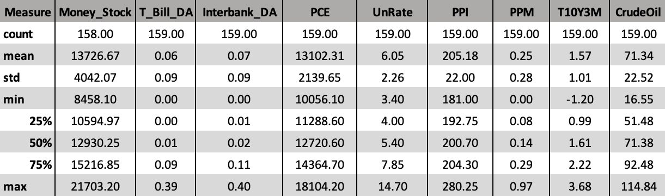
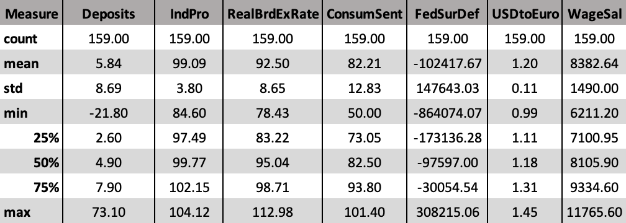
Statistical description
Notes:
Juliette
Transformed the predictors to first-order differencing
Treated outliers with IQR approach (created an upper and lower bound)
Used min-max scaler technique to normalize predictors to a particular range
Min-max scaler uses minimum and maximum values of each respective predictor to scale data

Slide 11
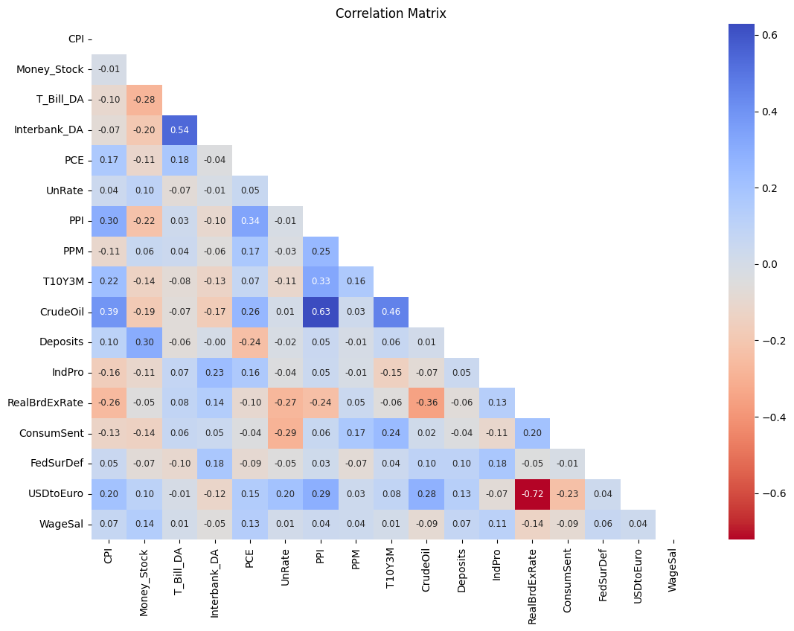
Correlation analysis
Most features are moderately or weakly correlated with CPI
Since labels and predictors have been differentiated, strong correlation no longer holds
Notes:
Yaismin

Slide 12
Statistical test
White Noise
ADF and KPSS

Slide 13
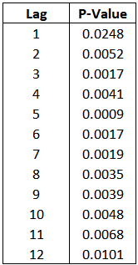
White noise check
If data is white noise, all models pointless
Ljung-Box test
Test for autocorrelation
Iterative process
P-values collected
Null Hypothesis: autocorrelation exists
Alternative Hypothesis: no autocorrelation/white noise
Significance level: 0.05
Notes:
Ryan

Slide 14
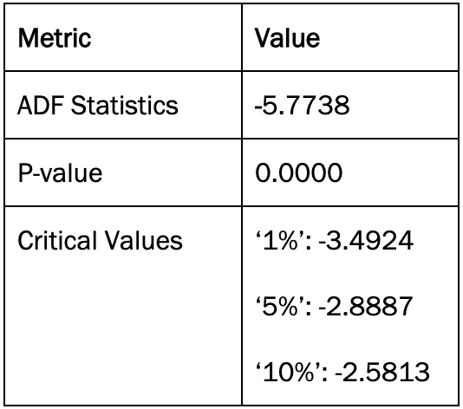
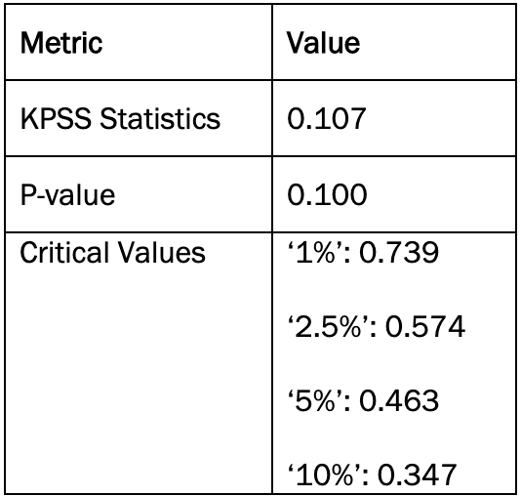
ADF and KPSS Test
Notes:
Ryan?
ADF and KPSS are time test to analyze the stationarity of the data
ADF is not always reliable, so even though the results proved to be stationary, we performed KPSS to ensure stationary.
ADF:
P-val < 0.05
Critical values > ADF stats
KPSS:
P-val < 0.05
Critical values > KPSS Stats

Slide 15
method
ARIMA
Random Forest without Label Lag Components
Random Forest with Label Lag Components
Long Short-Term Memory

Slide 16
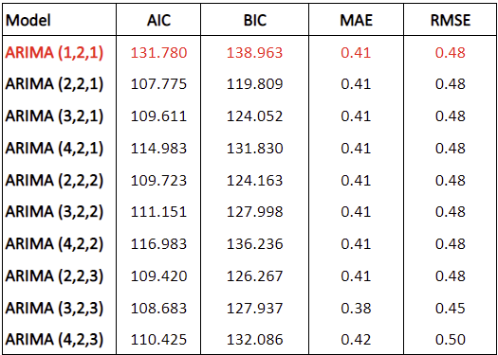
ARIMA
Notes:
Nam

Slide 17
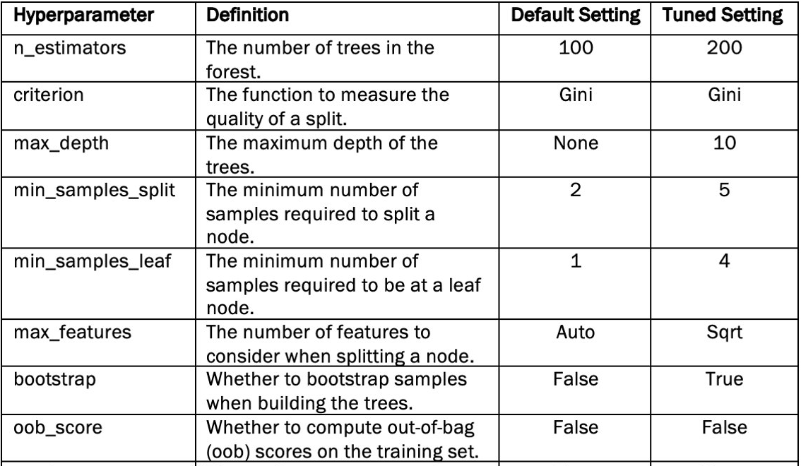
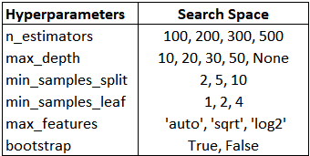
Random forest without Label lag components
Notes:
Nam
Cited article

Slide 18
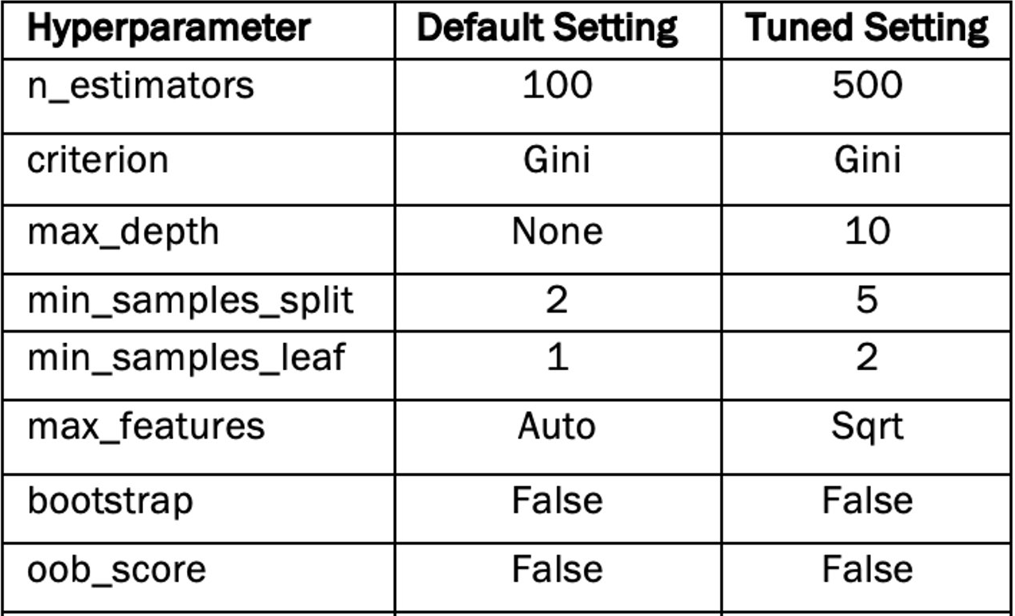
Random forest with Label lag components
Notes:
Nam

Slide 19
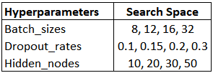
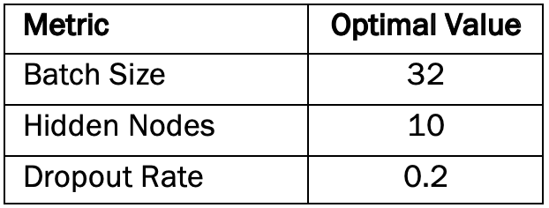
Long short-term memory (lstm)
A special form of recurrent neural network
Number of timestep used: 1
Optimization: Adam
Activation function: Tanh
EarlyStopping, Callbacks (Patience = 5): Enabled
Notes:
Nam
Small timestep: already include label's lag, small dataset, curse of dimensionality.
Early stopping, callbacks enabled. Loop through multiple batch sizes, hidden nodes, dropout rate and these resulted in the lowest mse on the validation data.
Optimization: Adam

Slide 20
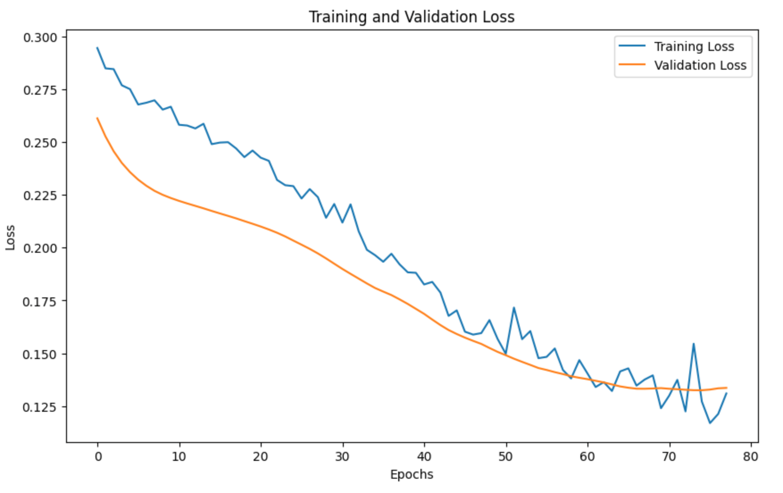
Long short-term memory (lstm)
Notes:
Nam
Though we set the set epoch = 100 in the model's setting, the model stops the training process at around 80 epochs since after the mse stop showing improvement after 5 epochs

Slide 21
Analyses and results
Statistical Discussions
Results with Differenced Data
Results with Back Transformed Data

Slide 22
Statistical discussions
Model Evaluation Metrics Used:
Mean Absolute Error (MAE)
Tells us on average how much our predictions are off without considering direction
Gives equal weight to all errors
Root Mean Square Error (RMSE)
Gives more weight to larger errors because they are squared before averaged
More sensitive to outliers
*Lower values indicate better performance*
Notes:
Juliette

Slide 23
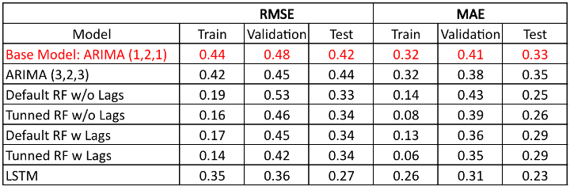
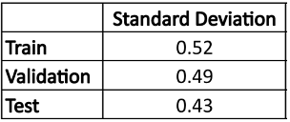
Results with Differenced Data
Notes:
Juliette
RMSE and MAE scores are all lower than the sd of the corresponding dataset
Including the label's lags help reduce RMSE on the train and validation data, but it does not generalize very well on the unseen data. For ARIMA models, all error terms are not statistically significant.

Slide 24
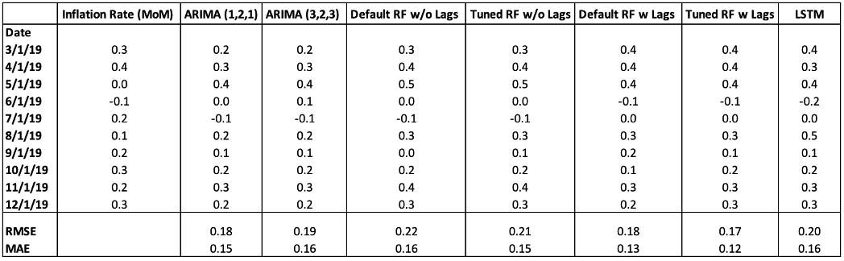
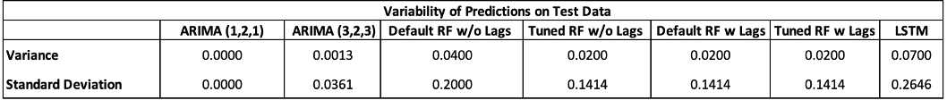
Results with back transformed data
Notes:
Nam

Slide 25
Conclusion
LSTM presented the best predictive performance on the transformed CPI data.
With the original data, the monthly inflation rate predicted by the Random Forest with tuned hyperparameters including the label lags had the best performance
Extending the data and exploring alternative methods could improve forecasting abilities.
Establishing a robust method to forecast inflation can benefit both governments and businesses.
Notes:
Yaismin/Nam

Slide 26
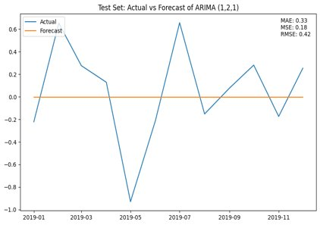
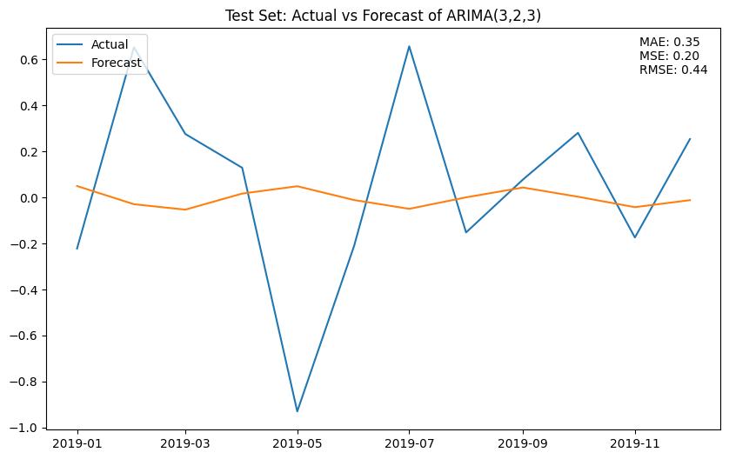
APpendix

Slide 27
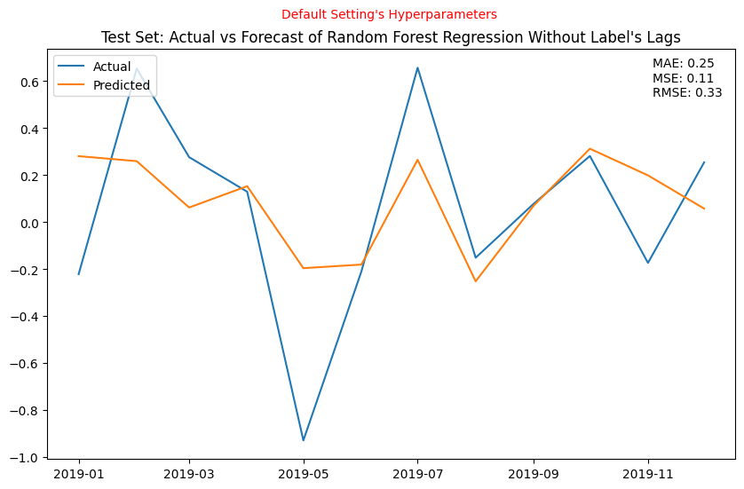
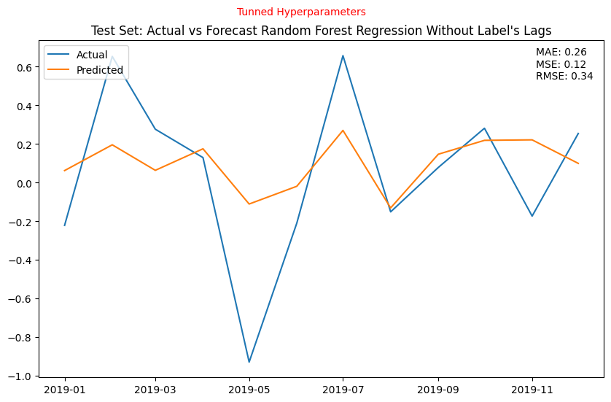
Appendix

Slide 28
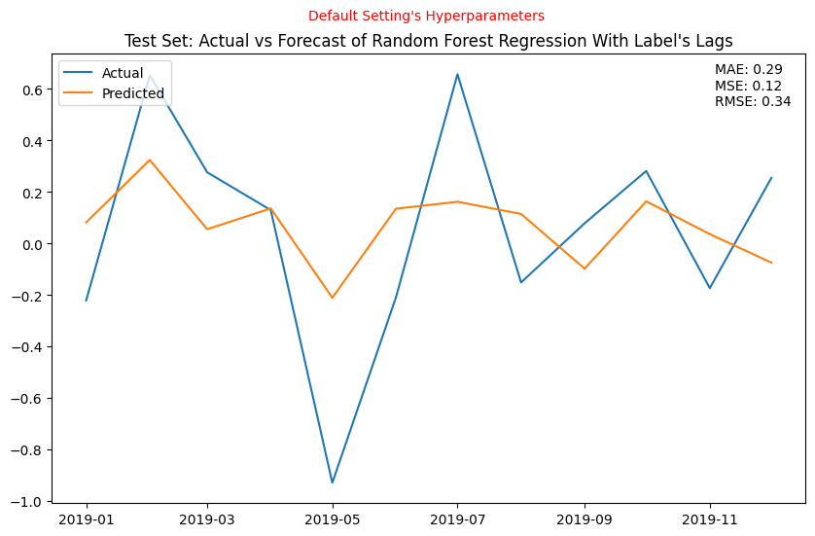
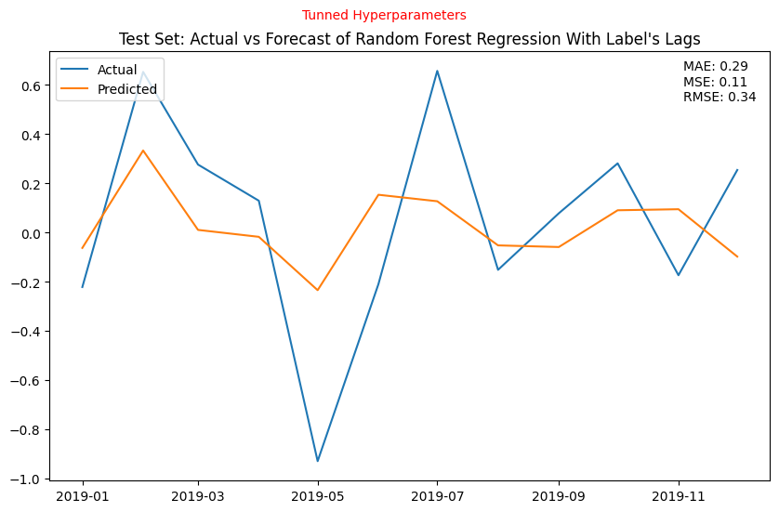
appendix

Slide 29
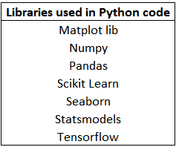
Appendix

Slide 30
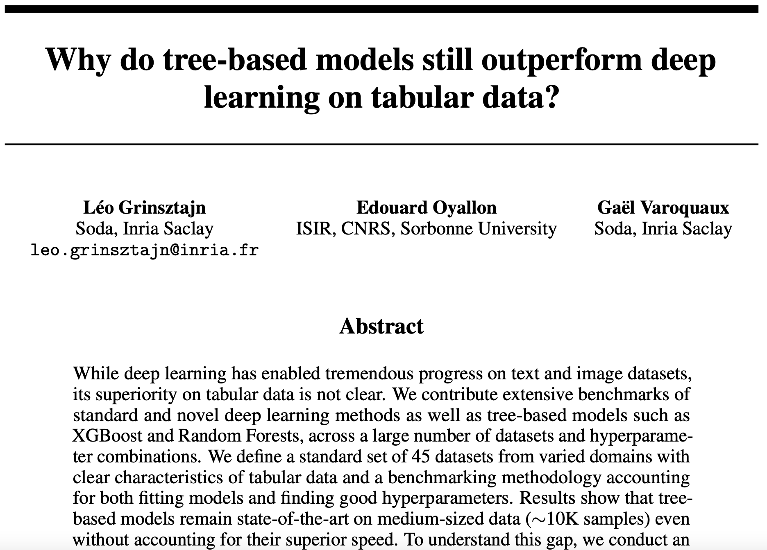
appendix

Slide 31
Thank you questions?

